Slide 1
Industrial PPE Detection using Computer Vision
GOKUL RAM SUBRAMANI
MS CSE, University at Buffalo
HARIHARAN VENKATARAMAN
MS Robotics, University at Buffalo

Slide 2
INTRODUCTION
As industries continue to expand globally, the significance of Personal Protective Equipment (PPE) becomes increasingly crucial in ensuring the safety of workers.
But at times workers in the industry don’t wear PPE which makes them prone to severe injuries and accidents
Preventing accidents and injuries through PPE compliance not only protects human lives but also results in cost savings for organizations.
Examples of PPE in industries include helmets, safety goggles, shoes, gloves etc

Slide 3
MOTIVATION
Traditional methods of monitoring PPE usage often rely on manual checks, making it challenging to ensure immediate compliance. Computer Vision allows for real-time monitoring, enabling quick identification of non-compliance and prompt corrective actions.
By automating the detection of PPE usage, we can significantly enhance workplace safety.
Deep learning techniques, such as Convolutional Neural Networks (CNNs), have been widely utilized in various solutions to detect and categorize Personal Protective Equipment (PPE) in real time

Slide 4
OBJECTIVE
Our project revolves around Industrial PPE Detection using Computer Vision. The application aims to enhance workplace safety by utilizing advanced image processing techniques to monitor and ensure workers are equipped with necessary Personal Protective Equipment (PPE).
The inputs comprise images or videos of workers in industrial settings, while the outputs involve real-time alerts for non-compliance, data storage for analysis, and a detailed list of detected PPE items.

Slide 5
OVERVIEW OF YOLO
To carry out the multi-object detection problem in Computer Vision we have made use of the YOLO algorithm which is basically a network of CNN for performing object detection in real time.
This algorithm deals with localizing a region of interest within an image and predicting the label for the localized interest region
One of the key technique used in YOLO is the concept of non-maximum suppression that is used to improve the accuracy and efficieny of object detection
There are various versions of YOLO, for our project we have made use of the latest YOLOv8 algorithm

Slide 6
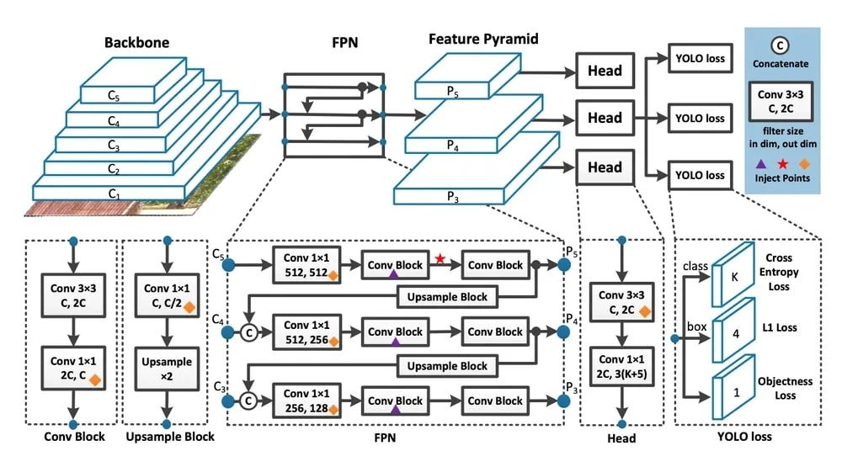
YOLOv8 ARCHITECTURE

Slide 7
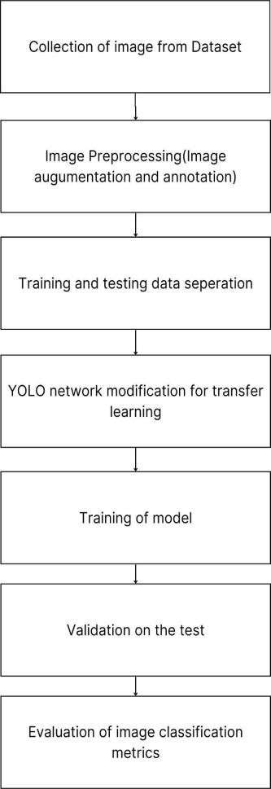
WORKFLOW OF THE SYSTEM
5x5 Median Filtering on train dataset

Slide 8
WHY MEDIAN FILTERING?
Median filtering is effective against reducing different types of noise in image. The main idea of median filtering is that it replaces each pixel value in its local neighbourhood with its median value
Unlike other smoothing filters median filters is less likely to blur edges in image. It preserves edge details while at the same time effectively reducing noise
Median filters can also enhance certain features of objects in an image by removing unwanted noise and smoothing the background.

Slide 9
DATASET USED
The dataset that was used for this project was: https://universe.roboflow.com/trialforobjectdetection/ppe-v1.1/browse?queryText=&pageSize=50&startingIndex=0&browseQuery=true
The dataset contains images with different PPE classes(glove, goggles, helmet, shoes, no-glove, no-goggles, no-helmet, no-shoes)
Image augmentation is done to increase the size of the dataset and for improved generalization

Slide 10
TRAINING OF MODEL
So before training the model, the images in the train dataset was filtered using median filter with a kernel size of 5*5
The dataset is trained with YOLOv8 algorithm for 30 epochs and image sizes of 800*800*3(3 denotes the channel of the image)

Slide 11
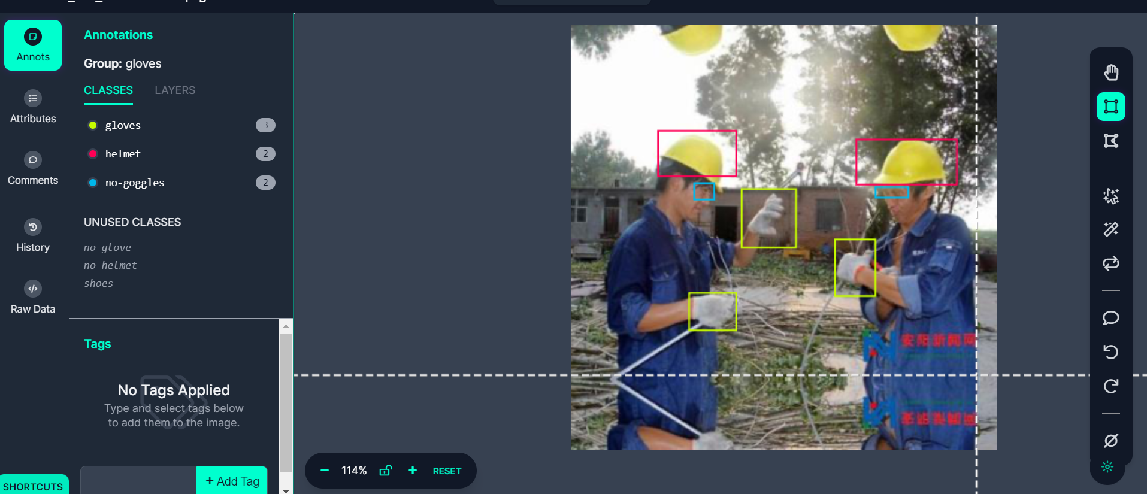
RESULTS AND COMPARISION
Box annotation for images on the dataset

Slide 12
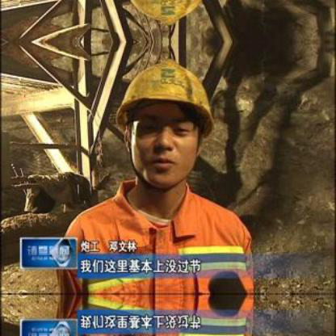

Image before median filtering
Image after median filtering

Slide 13
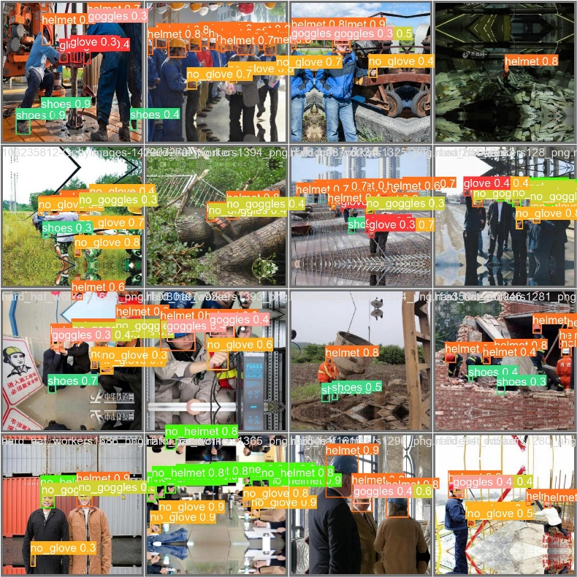
Batch of test images predicted by build model

Slide 14
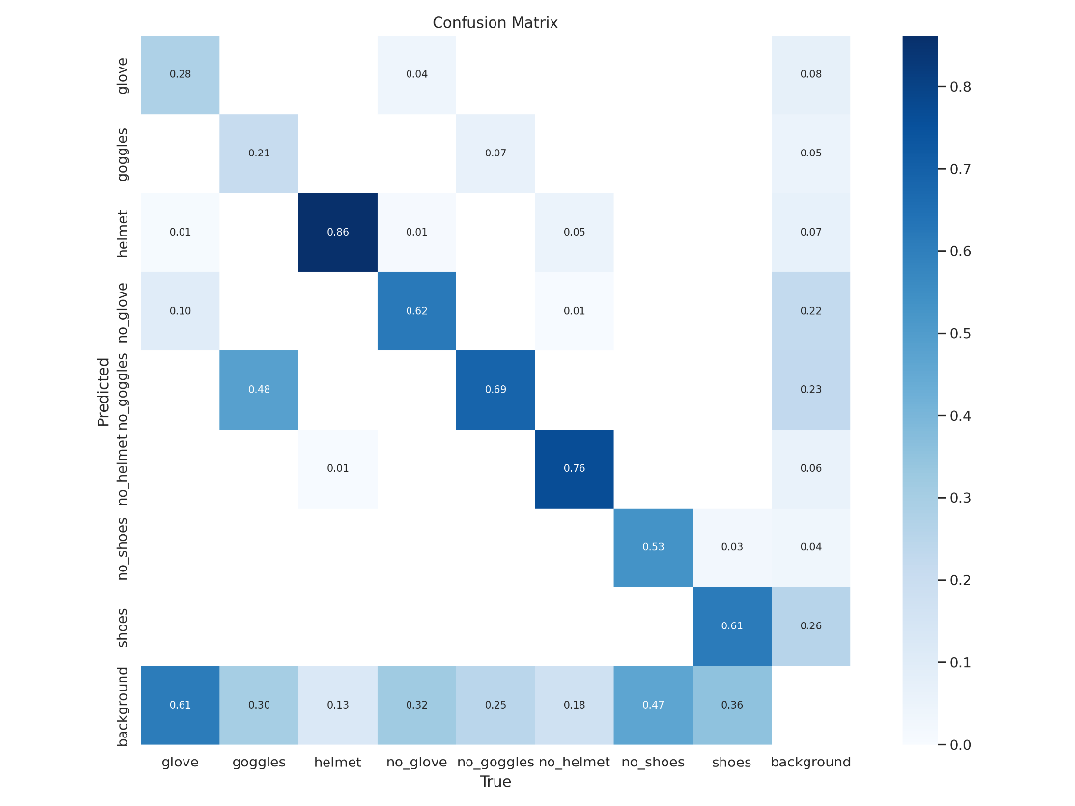
Confusion matrix for different classes

Slide 15
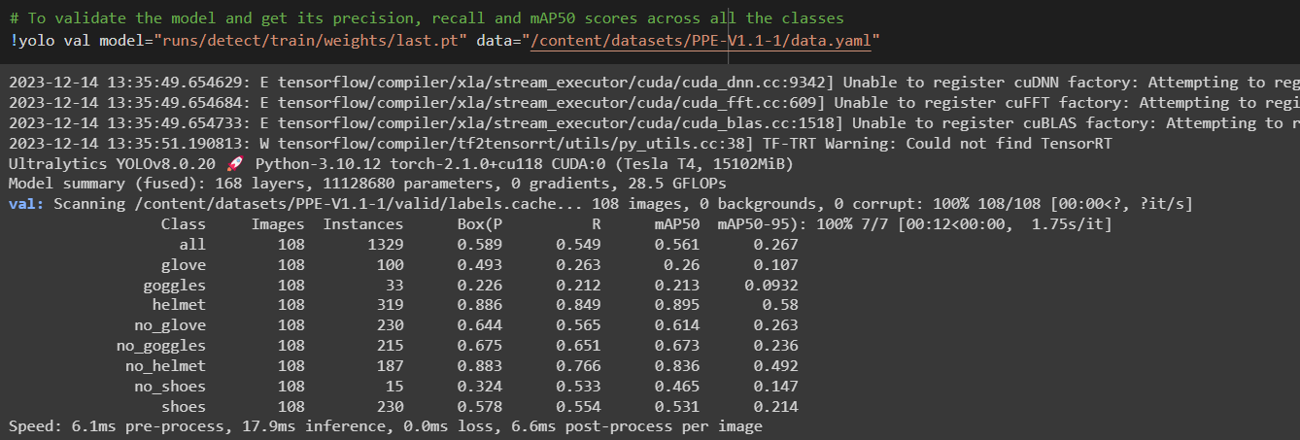
Model validation results over different classes

Slide 16
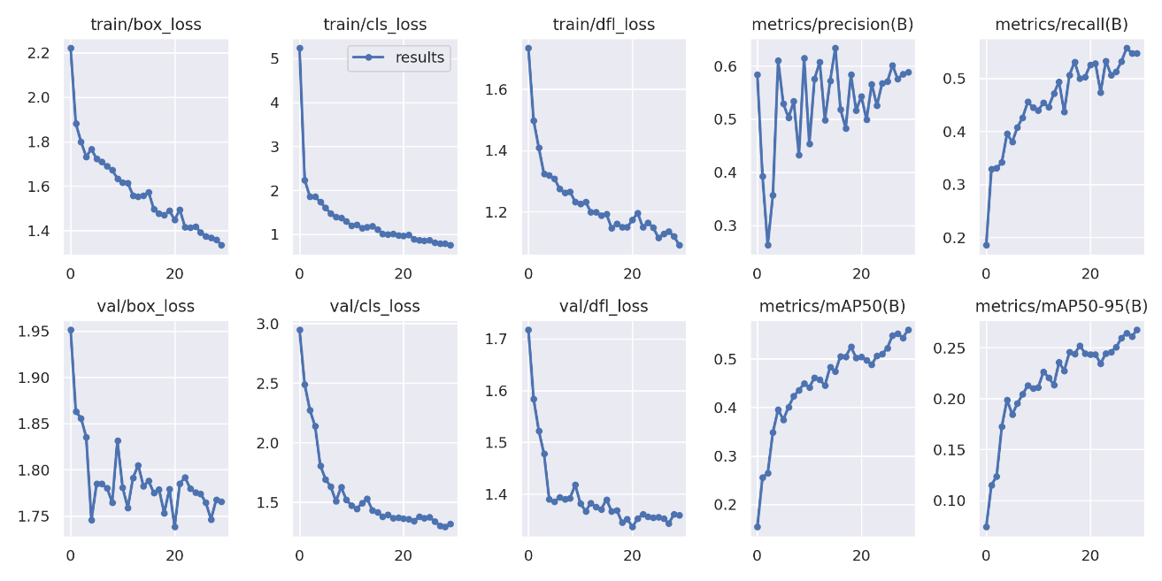
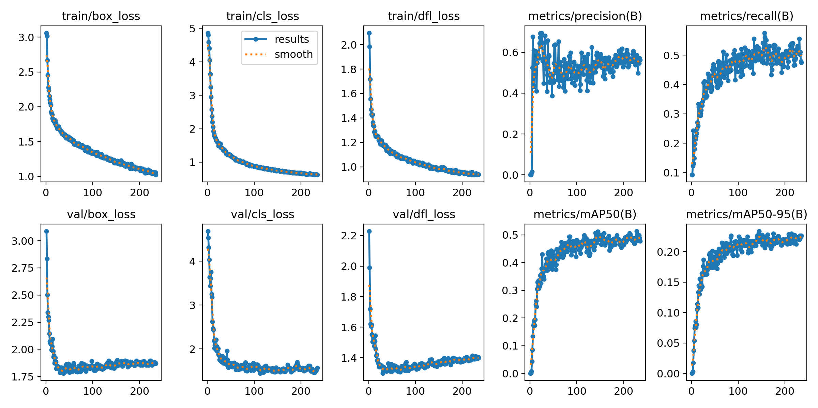
Our Median filtered YOLO model vs State of the art YOLO model
Our trained YOLOv8 model with Median Filtering
Roboflow trained YOLOv8 model
Improvement in Precision, Recall and Mean Average precision for median filtered YOLOv8 model over YOLOv8 model

Slide 17
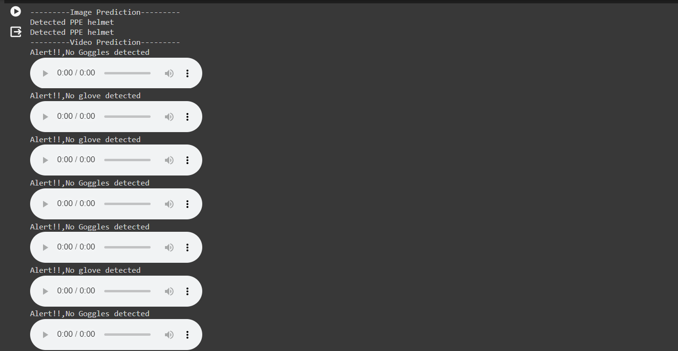
Model testing on image and video in real-time with instant alert when no-PPE class is detected

Slide 18
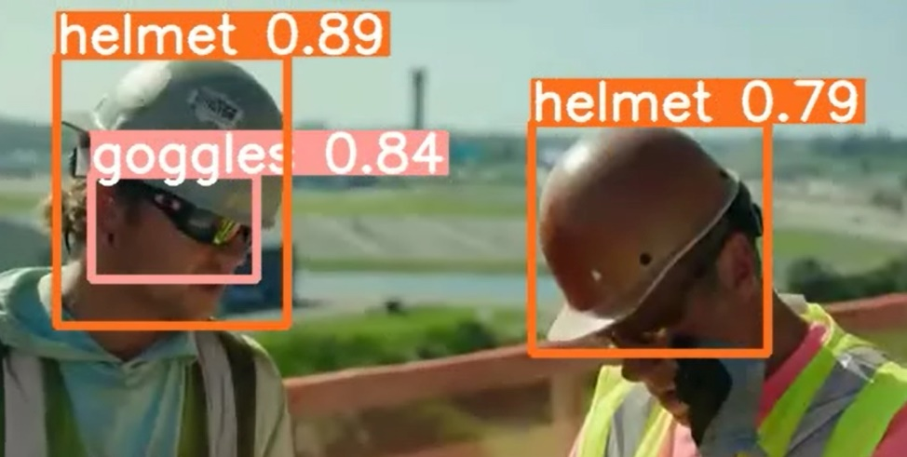
Testing model on a test video which could be used as real-time video application

Slide 19
CONCLUSION
From this project, We have gained substantial insights into the realm of computer vision and its practical applications in ensuring workplace safety through PPE detection
YOLO uses in multi-class object detection problem and how it could be used in transfer learning for solving a specific object detection task.
Various image processing techniques that could lead to significant improvement in the performance of the state of the art model was learned and implemented
The proficiency gained in developing PPE detection systems can be extrapolated to diverse industries like manufacturing, healthcare, construction, and more

